Slide 1
Eye-disease Classification using Convolutional Neural Networks (CNN) and TensorFlow

Slide 2
Introduction
This project’s aim is to leverage cutting-edge deep learning algorithms to build a robust eye disease classification system that can significantly enhance the efficiency and effectiveness of eye healthcare.
This project leverages Convolutional Neural Networks (CNNs) and transfer learning to build an automated eye disease classification system. The goal is to enable early and accurate detection of conditions like diabetic retinopathy, cataracts, and glaucoma. By automating the diagnostic process, the system aims to improve accessibility and efficiency in eye healthcare, ultimately leading to better patient outcomes. The deep learning algorithms are trained on medical image data to achieve high classification accuracy.

Slide 3
Statement of the problem
The main problem addressed by this project is the development of an automated, deep learning-based eye disease classification system to enable early and accurate diagnosis of critical conditions like diabetic retinopathy, cataracts, and glaucoma.
By leveraging Convolutional Neural Networks (CNNs) and transfer learning, the project aims to create a reliable, scalable solution that can improve the accessibility and efficiency of eye healthcare, particularly in resource-constrained settings where expert diagnosis may be limited.

Slide 4
Objective
The main objective of this project is to develop a robust, automated eye disease classification system using Convolutional Neural Networks (CNNs) and transfer learning techniques.
The aim is to create a highly accurate model that can reliably detect and differentiate between common eye diseases, including diabetic retinopathy, cataracts, and glaucoma. By leveraging the power of deep learning, the project seeks to enhance the efficiency and accessibility of eye healthcare, enabling early diagnosis and timely treatment to improve patient outcomes, particularly in areas with limited access to specialized ophthalmological services. The proposed solution could serve as a valuable tool for supporting medical professionals and empowering patients in the fight against vision-threatening eye conditions.

Slide 5
Scope
Create a deep learning-based system using Convolutional Neural Networks (CNN) and transfer learning to classify common eye diseases such as diabetic retinopathy, cataracts, and glaucoma.
Develop a scalable, automated solution to improve early detection and accessibility in eye healthcare.

Slide 6
Application
The automated deep learning model can enable early and accurate detection of eye diseases, allowing for timely intervention and treatment.
By automating the diagnostic process, the system can improve accessibility to eye healthcare, especially in areas with limited access to specialist ophthalmologists.
The system can be used as a screening tool to efficiently identify high-risk individuals, allowing for prioritized referrals and optimized resource allocation.
The classification model can serve as a decision support tool, assisting doctors and ophthalmologists in making more informed diagnoses and treatment decisions.

Slide 7
Limitations
The model may overfit the training data if the dataset is not large or diverse enough, leading to poor generalization.
Variations in image quality, resolution, and differences in imaging devices can negatively impact the model's accuracy.
The system might struggle with accurately classifying rare or atypical eye diseases, and differences in patient demographics can further affect performance.

Slide 8
Developmental Tools used
The tools and libraries used in building the model are :
Python 3.6 (Language)
NumPy (Python Library)
Matplotlib (Python Library)
Pandas (Python Library)
SciKit-Learn (Python Library)
TensorFlow (Python Library)
Keras (Python Library)
Seaborn (Python Library)
Cv2 (Python Library)
OS (Python Library)

Slide 9
Algorithms Inculcated
Convolutional Neural Networks (CNNs)
Transfer Learning

Slide 10
Algorithm
Start
Import essential libraries like numpy, pandas, matplotlib, seaborn, os, TensorFlow, Keras, scikit-learn, and others required for the project.
Load the image dataset and set the path.
Transform the image dataset into a data frame and read the data.
Inspect the data to understand its structure and content.
Perform data augmentation, then visualize the data.
Split the data, defining target and feature values.
Apply additional data augmentation using ImageDataGenerator.
Build the model using different approaches, such as CNN and transfer learning.
Check the model summary and label the data.
Evaluate the model by checking accuracy and other relevant metrics.
Plot visualizations to examine train-test accuracy, validation, and other metrics.

Slide 11
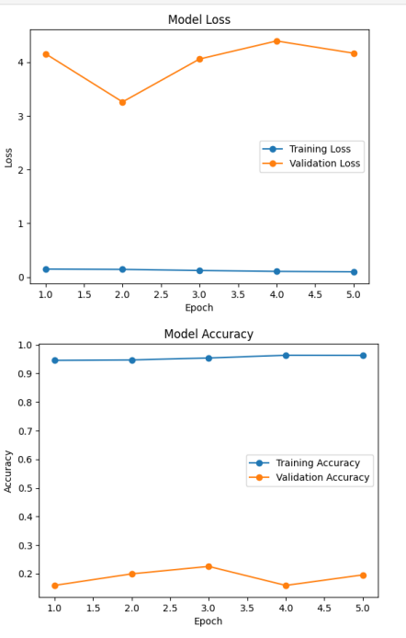
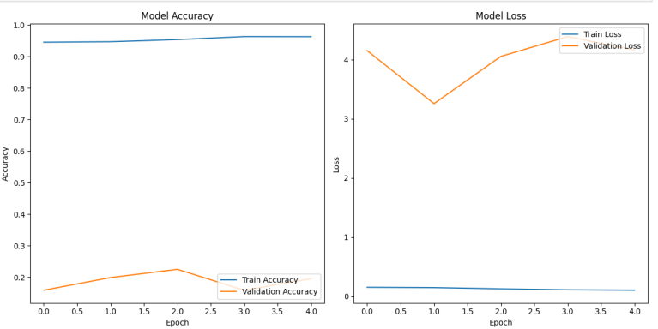
OBSERVATION
Model accuracy vs Model loss

Slide 12
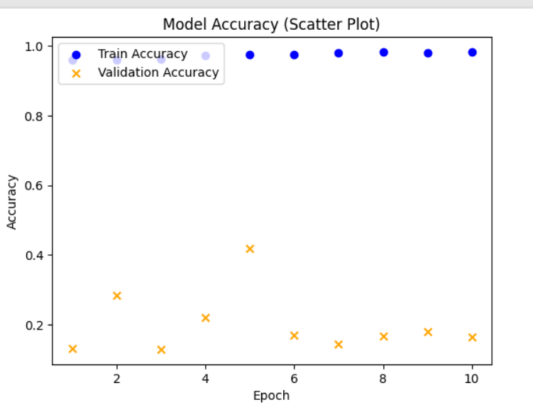
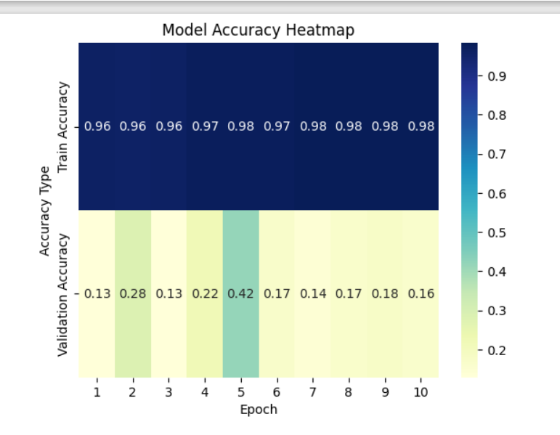
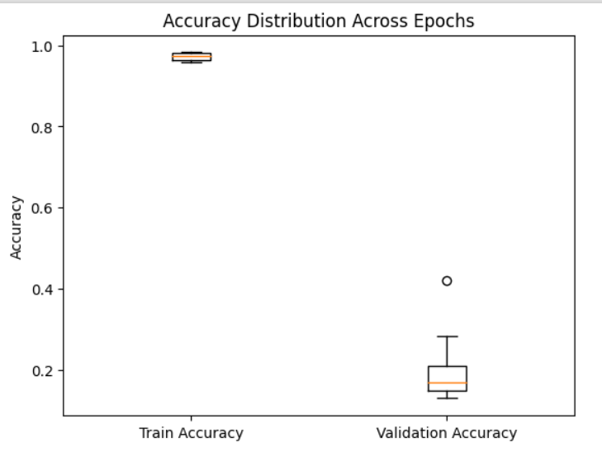
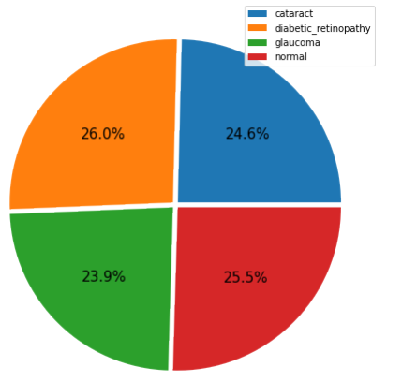
OBSERVATION

Slide 13
Conclusion
This study utilized Convolutional Neural Networks (CNN) and transfer learning with a pre-trained EfficientNet model to classify eye diseases such as cataracts, diabetic retinopathy, and glaucoma. The results demonstrated significant improvements in accuracy, recall, precision, and F1 scores compared to CNN alone, indicating the potential of deep learning in enhancing ophthalmic diagnostics and addressing global eye health challenges effectively.

Slide 14
Sources
Eye_diseases_classification dataset from Kaggle (link)

Slide 15
THANK
YOU!

